Slide 1
Email Spam Detection

Slide 2
Abstract
Nowadays communication plays a major role in everything be it professional or personal. Email communication service is being used extensively because of its free use services, low-cost operations, accessibility, and popularity. Emails have one major security flaw that is anyone can send an email to anyone just by getting their unique user id. This security flaw is being exploited by some businesses and ill-motivated persons for advertising, phishing, malicious purposes, and finally fraud. This produces a kind of email category called SPAM.
Spam refers to any email that contains an advertisement, unrelated and frequent emails. These emails are increasing day by day in numbers. Studies show that around 55 percent of all emails are some kind of spam. A lot of effort is being put into this by service providers. Spam is evolving by changing the obvious markers of detection. Moreover, the spam detection of service providers can never be aggressive with classification because it may cause potential information loss to incase of a misclassification.
To tackle this problem we present a new and efficient method to detect spam using machine learning and natural language processing. A tool that can detect and classify spam. In addition to that, it also provides information regarding the text provided in a quick view format for user convenience.

Slide 3
Contents:
Introduction
Prerequisites
Softwares and Tools Used
Application Overview
Code Walkthrough
Running of Application
Conclusion

Slide 4
Introduction: Email spam detection is an essential aspect of maintaining secure and efficient digital communication. Spam emails often contain malicious content, phishing attempts, or unnecessary advertisements that clutter inboxes and pose risks to users. With the increasing volume of email traffic, automated spam detection systems have become crucial. This project demonstrates the integration of a machine learning-based spam detection model with a Flask web application to deliver an intuitive and efficient solution.

Slide 5
Prerequisites:
Python 3.7 or later installed.
Basic understanding of Flask and Python programming.
A trained spam detection model saved in joblib format.
Required Python libraries installed.

Slide 6
Softwares and Tools Used:
Python Libraries:
Numpy
Pandas
Scikit-Learn
Joblib
Web FrameWork
Flask
Frontend Technologies
HTML
Css
JavaScript
Development Environment
Google Collab
Visual Studio Code
Web Browser

Slide 7
Application Overview:
1. Web interface for user input
2. Backend for email classification
3. Real-time results using a trained ML model

Slide 8
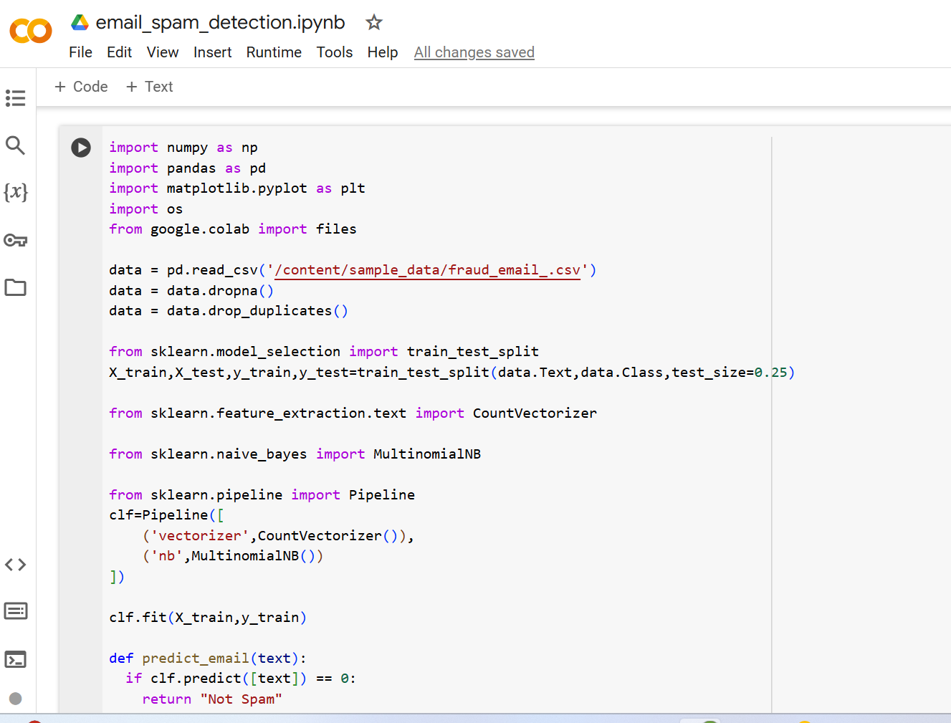
Code WalkThrough:
Machine Learning Model:

Slide 9
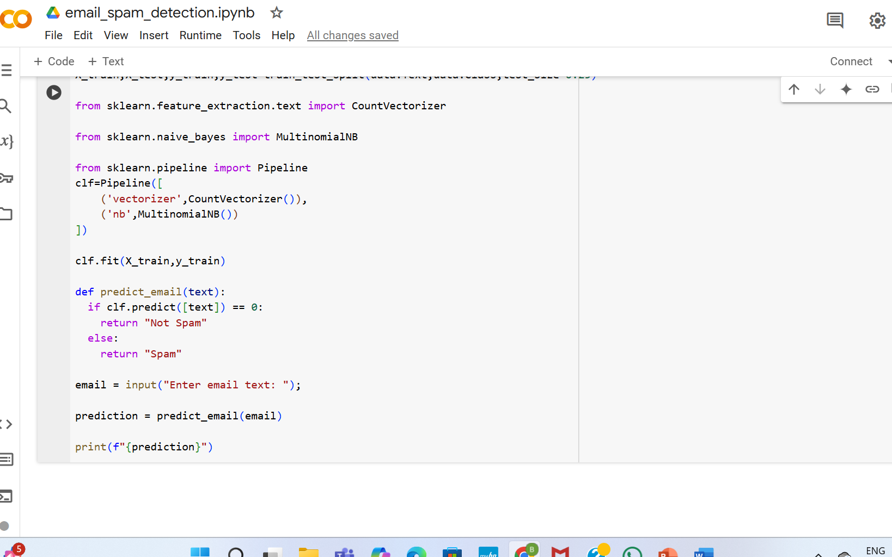

Slide 10
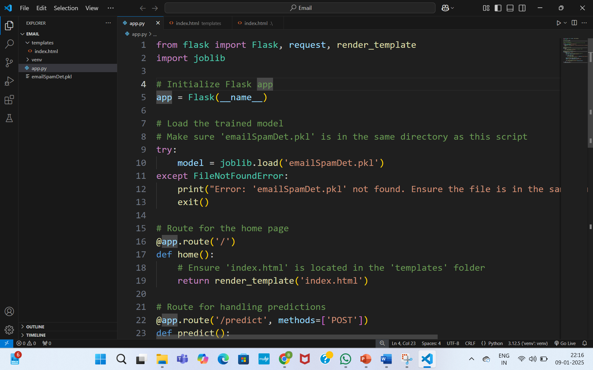
Flask FrameWork:

Slide 11
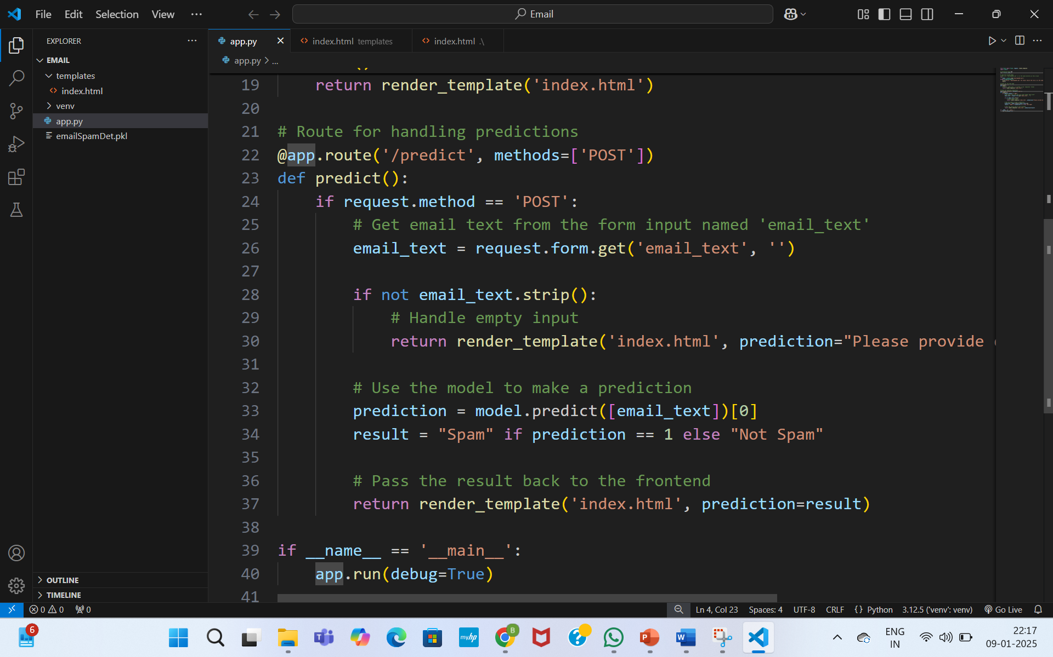

Slide 12
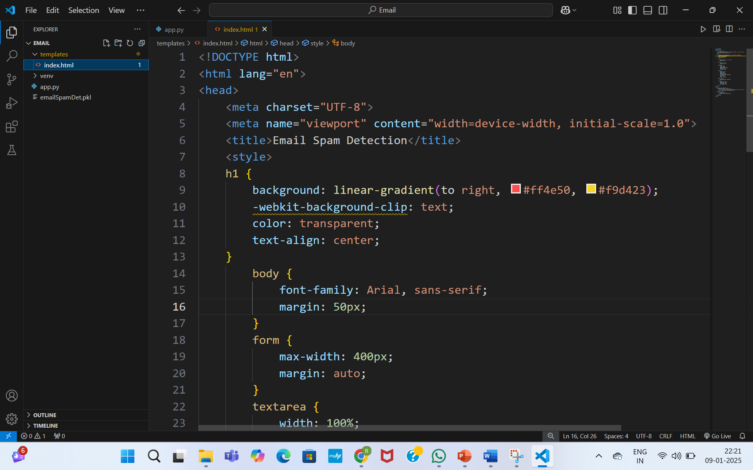
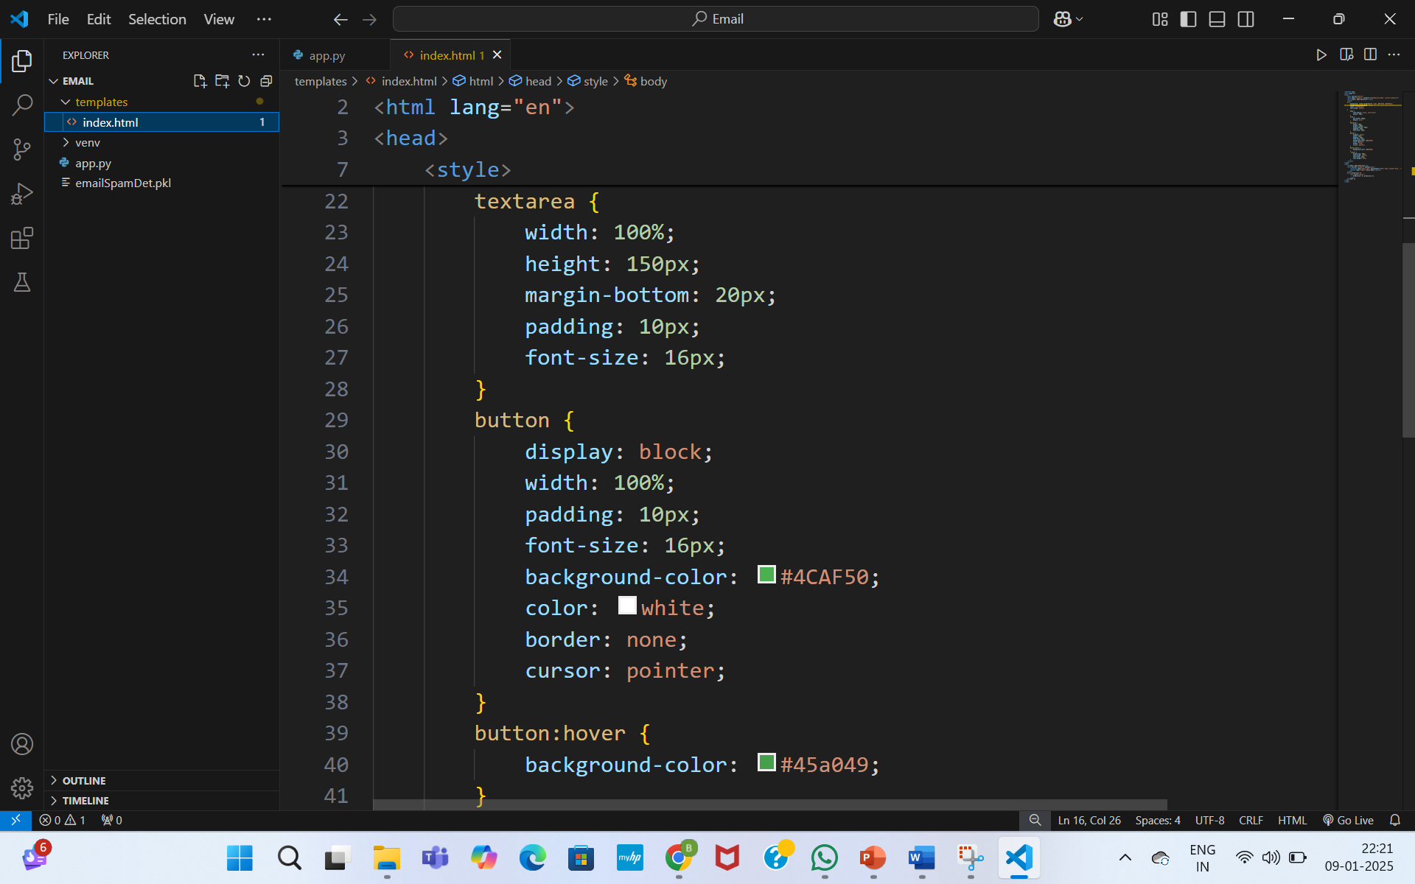
Frontend Integration:

Slide 13
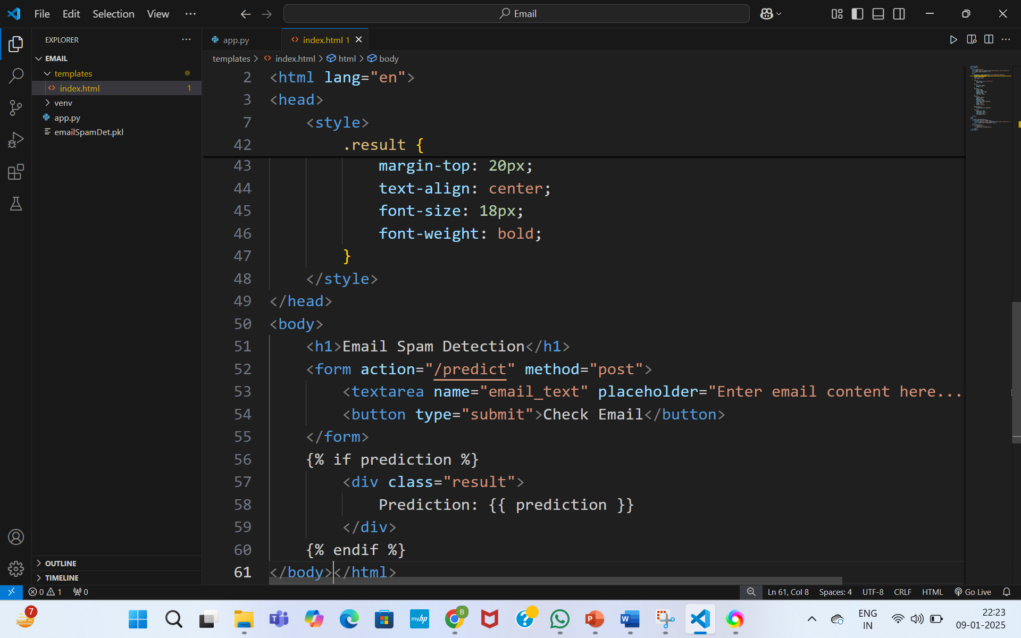

Slide 14
Running the Application: 1. Navigate to the project folder 2. Run the application: python app.py 3. Access the app at http://127.0.0.1:5000/

Slide 15
Conclusion: This Email Spam Detection application demonstrates the integration of machine learning models into web applications. It is a scalable, user-friendly solution for spam filtering with potential for further enhancements.

